Slide 1


Mentoring
Understanding the world around us
A look into Belarus
Abbie Hodge

Slide 2
About me
 | Second-Year International Affairs Scholar Major: International Relations and Diplomacy Minor(s): Middle East Studies and Public Policy I hope to become a Diplomat or Foreign Service Officer/ work with refugees and immigrants

Slide 3

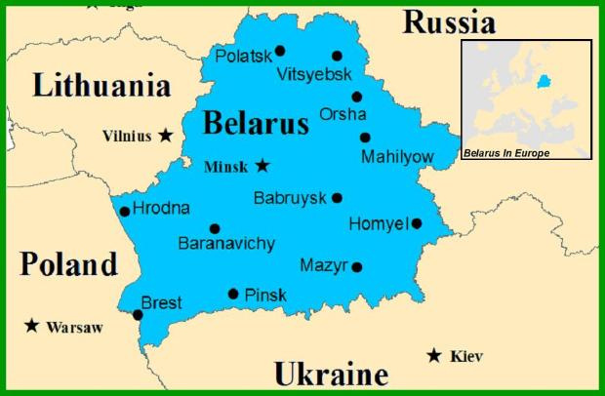
Mentoring the Family
I have worked with the resettlement agency since August when they arrived in central Columbus. The family is from Belarus and I aid the mom, and two daughters (21 and 16 years old). Throughout these slides, I want to share the ups and downs/ general experience with this process and information about Belarus.

Slide 4
Mentor Blogs
Upon their arrival in August 2023, I mentored a family of three (dad in Turkey) from Belarus. They got their visa from Tbilisi, Georgia through the US Embassy there as the one in Minsk is closed. Additionally, they now live in central Columbus and the daughter is moving back to Belarus in April. The older daughter is completing a digital design certification through Columbus State and the younger is a freshman in High School.
We brought in another mentor as I was in charge of three people, I found this helpful as she speaks Russian the mom does not speak English and the daughter is in the ELS program.
https://global-scholars-project.webnode.page/mentor-blogs/

Slide 5
What I learned
starting in August, I started to mentor.
  Key Focuses: Adjusting to Columbus, education, financial and legal needs, social aspects, and mental health.
  When I started mentoring I thought I would be helping them with homework. I realized I wanted to help them in multiple areas, if no one were going to be there, I would be there for them.
  Setting boundaries is crucial- they would ask me to get them jobs or figure out their education. I learned to guide them in the process, but not do everything for them.
  Seeing raw human emotion and being able to handle this is very important, I was a liaison between their attorney and caseworker- I was able to communicate their needs effectively when they couldn’t. I wanted to make sure they were being seen.
  Seeing their growth in this process makes all the stress worth it- they are starting to get a hang of life here and become further adjusted. Forming a genuine friendship and having laughs is what I am here for.

Slide 6
Quotes from Blog
“She has mentioned she is in an ELS program and has a specific teacher for this. She has also said how she and this guy were looking at a globe in the classroom and he asked where she was from and she said Belarus and he had no idea where that was. She said he kept looking around the globe and didn't know where it was”
“She is upset why education is so difficult to understand as the younger daughter has been adjusting to the increased course load of high school in the States. The younger daughter has mentioned how much more work she has here than back at "home."
“They want me to help them get a green card, get into school, find people in graphic design... which I can do I think I got overwhelmed because there are so many questions (which is normal I would have the same). I want to do everything in my power to help them but I can physically only do so much. I have sat down with the older daughter and combed through her transcript, her placement test, and the course requirements for different universities”

Slide 7
Culture (from blogs)
We talked about culture- they do not have a holiday similar to Thanksgiving/ they said Pumpkin Pie is not a thing in Belarus and is gross. They have salads with grapes and sausage; they miss meat from Belarus and the aftertaste and general taste is better there.
Belarusian food: Borscht with sour cream, bun and cinnamon, cream inside. Potato pancakes with sour cream, buns with cottage cheese inside (sweetened). Fish under a Winter Coat dish (translated). They said American mayo is weird, and the texture is rough and salty, in Belarus, it is in a packet.
They said Easter occurs- boil an egg for yourself and a friend/ beat it from top to bottom, if it smashes you lose (aka strongest egg wins). They boil eggs and put stickers on them-called them propaganda eggs because you decorate them with God's face.

Slide 8
Blogs (Continued)
“They went to go get groceries and their EBT card was cut off, they had $7 left and could not get the groceries they needed”
“We described a few jobs which do not require a lot of English, but she wants to go into the medical field and we found it difficult to explain that she needed to know more English- we know she could work for a company such as Amazon but that is not what she wants to do”
“The older daughter sent a picture of an eviction notice as they do not have money to pay their rent. This sent me into panic mode because the lawyer/ case worker was supposed to handle the issue but it was not handled”
“Her mindset has been fixed in this state since she arrived and I have been trying to make her situation better but she is still unhappy here and wants to leave”

Slide 9
Blogs (Final)
“The mom does not want to meet anymore because she has a job. She thinks she does not need help, but will call if she has questions. The older daughter has been pushing us out so I have been trying to balance giving her space and still aiding/ being her friend”
“The older daughter is going to Tbilisi, Georgia when reunited with her fiance as there is no US Embassy in Belarus. They are going to see about refugee status for the husband so they both can potentially visit”
“A group of guys kept walking around and continuously staring/ making a point to make it obvious; the other mentor and I both brought it up to each other”
I am sharing all of this to spread understanding and kindness. You never know what someone is going through, educate yourself and become culturally aware- our differences make the world go round.

Slide 10
The girl I mentor shared with me her life experience/ what Belarus is like... I have consent from her to anonymously share her story.
A look into Belarus
CULTURE: Old culture-puppet, drama, and musical theaters. “In our blood to quote our old writers, know their biographies, and visit where they lived.” Go to graves/ monuments of military or cultural figures once/ twice a year with school.
POLITICS/ 2021 PROTEST
President started taking away people's election votes, brainwashing the older generation about Western countries, and word propaganda. “We are poor people but still have the best products/ intelligence. People felt the need to fight/ keep fighting even though change had not been made.
SPIRITUALITY & RELIGION: Older generations are more religious and everyday life is based on Christianity. The younger generation considers themselves atheists. There is a strong sense of community- on Sundays pick up trash form common year.

Slide 11
Belarus (Continued)
PEOPLE: “We have the most open and kind people ready to help at any moment” Customary to dress beautifully, follow trends, and take care of self. Groups meet/ walk around the square- walking in the evenings is a tradition/ resting. People mostly walk around the city- cars show status vs a means of transportation.
POLITICS (PT 2): The head of state felt impunity...he started killing journalists and placed the people under total censorship. People went to the streets to protest, and with a strong spirit, these grew daily. This was the first revolt since 1994.
Faced a sea of blood as innocent people and mothers became imprisoned. Belarusians are scared and want peace and freedom.

Slide 12
“We are quiet and peaceful people who endure a lot, but I believe that someday better times will come and Belarus will open up to the whole world”

Slide 13
More on her story
Her boyfriend was detained during the protests/ people were simply walking on the street. “He was grabbed for nothing, beat with a baton at the police station and draggged by the hair, he was humiliated and insulted”
The police targeted the village of Okrestino- Women were assulted with batons and men were beaten to death
Her mom told her to not go outside at all, she was afraid her daughter would be taken too.
You can get out of Belarus through religion but it is difficult to leave.
There are still sanctions in place. The government has blocked rights to speak up about the government, we cannot wear red/ white (the flag protest colors), and the Belarussian language is not allowed. People cannot be real journalists and no one is allowed to do deals with American countries.

Slide 14
Educate yourself
Educate others
Educate the world

